Slide 1
Control of Large-Scale Motions in Turbulent Boundary Layers
Alex Tsolovikos
PhD Candidate
Supervisors: David Goldstein and Efstathios Bakolas
Department of Aerospace Engineering and Engineering Mechanics
The University of Texas at Austin
Tuesday, August 2nd, 2022

Slide 2
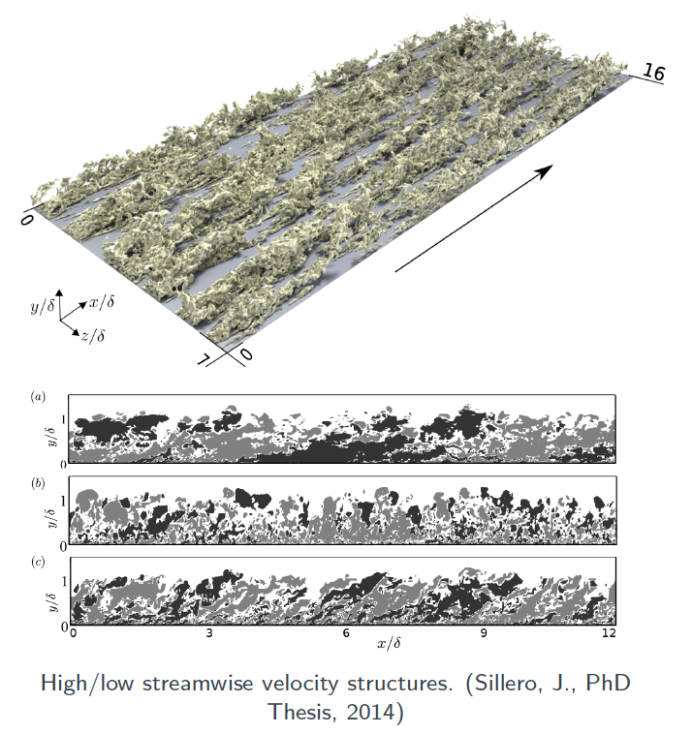
What is a Large-Scale Motion?
Coherent motions in wall-bounded turbulent flows
Characteristics:
Size in the order of the boundary layer thickness
Large fraction of the turbulent kinetic energy
Significant contribution to average Reynolds shear stresses
Consist of smaller structures (e.g. hairpin vortices)

Slide 3
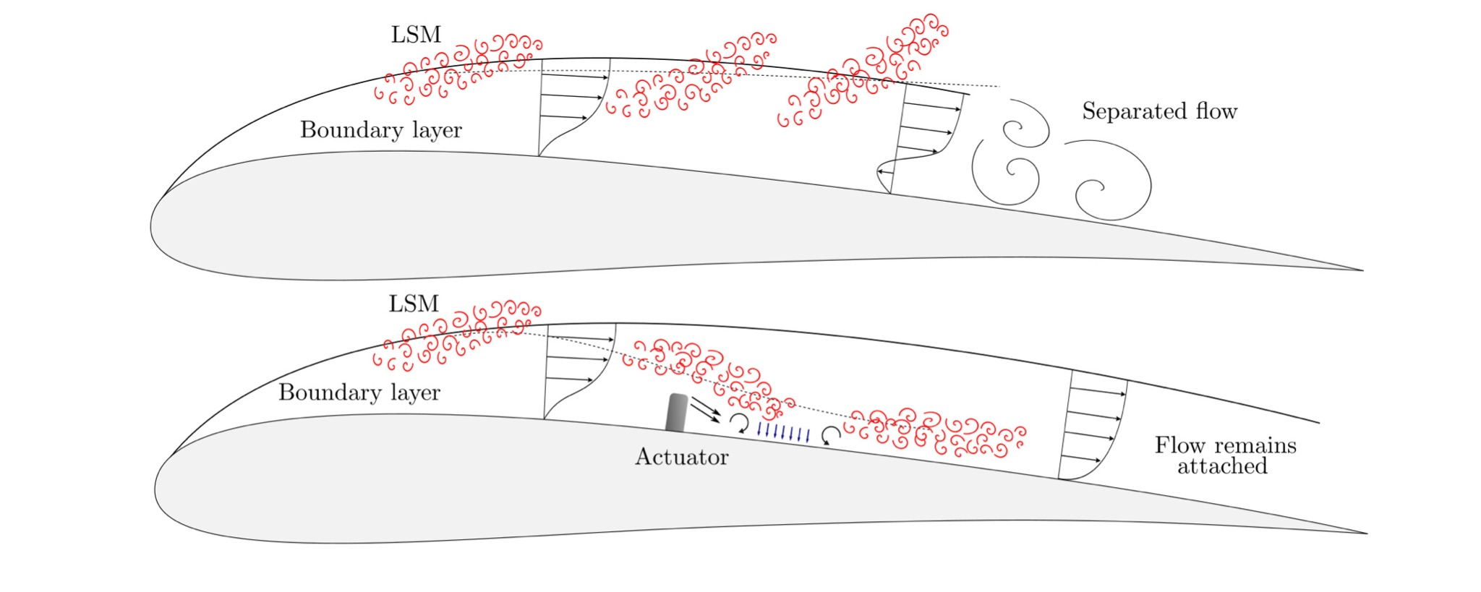
Control Scheme
Re-energize the boundary layer by moving LSMs toward the wall

Slide 4
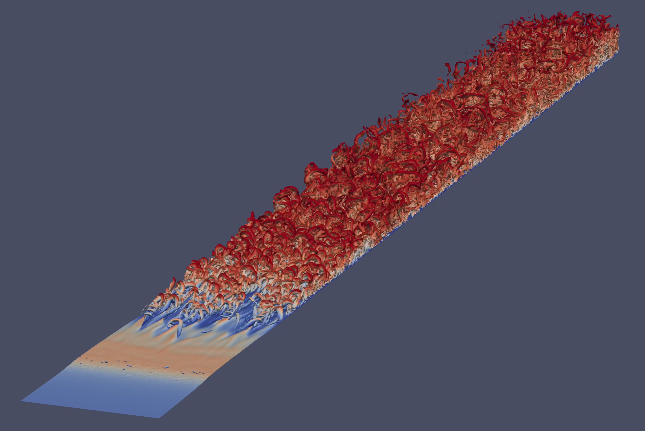
Turbulent Boundary Layer DNS
Q Criterion isosurfaces colored by height
Direct numerical simulation of a turbulent boundary layer at Re_{θ} = 1100 - 2000 using the spectral element code Nek5000 | Boundary layer is tripped with random streamwise forcing

Slide 5
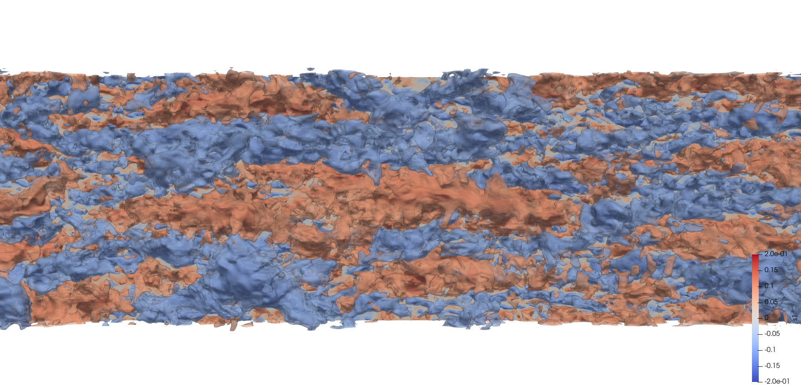
A Closer Look at Velocity Fluctuations
δ₉₉
Slow
Fast
Re_{θ} = 1800 | Isosurfaces at u’ = ±0.1U_{inf}

Slide 6
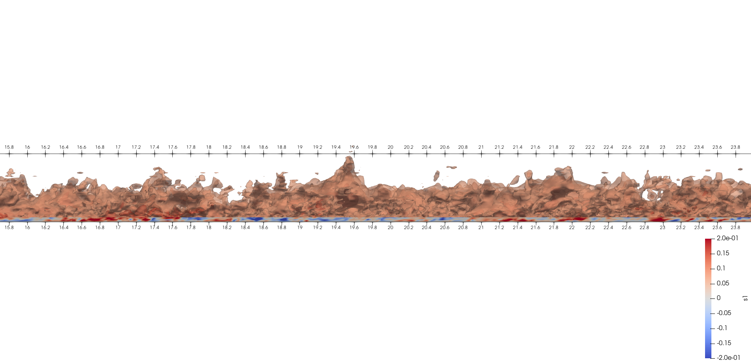
Side View of Positive Fluctuations
Fast
δ₉₉
Positive velocity fluctuations reside lower in the boundary layer

Slide 7
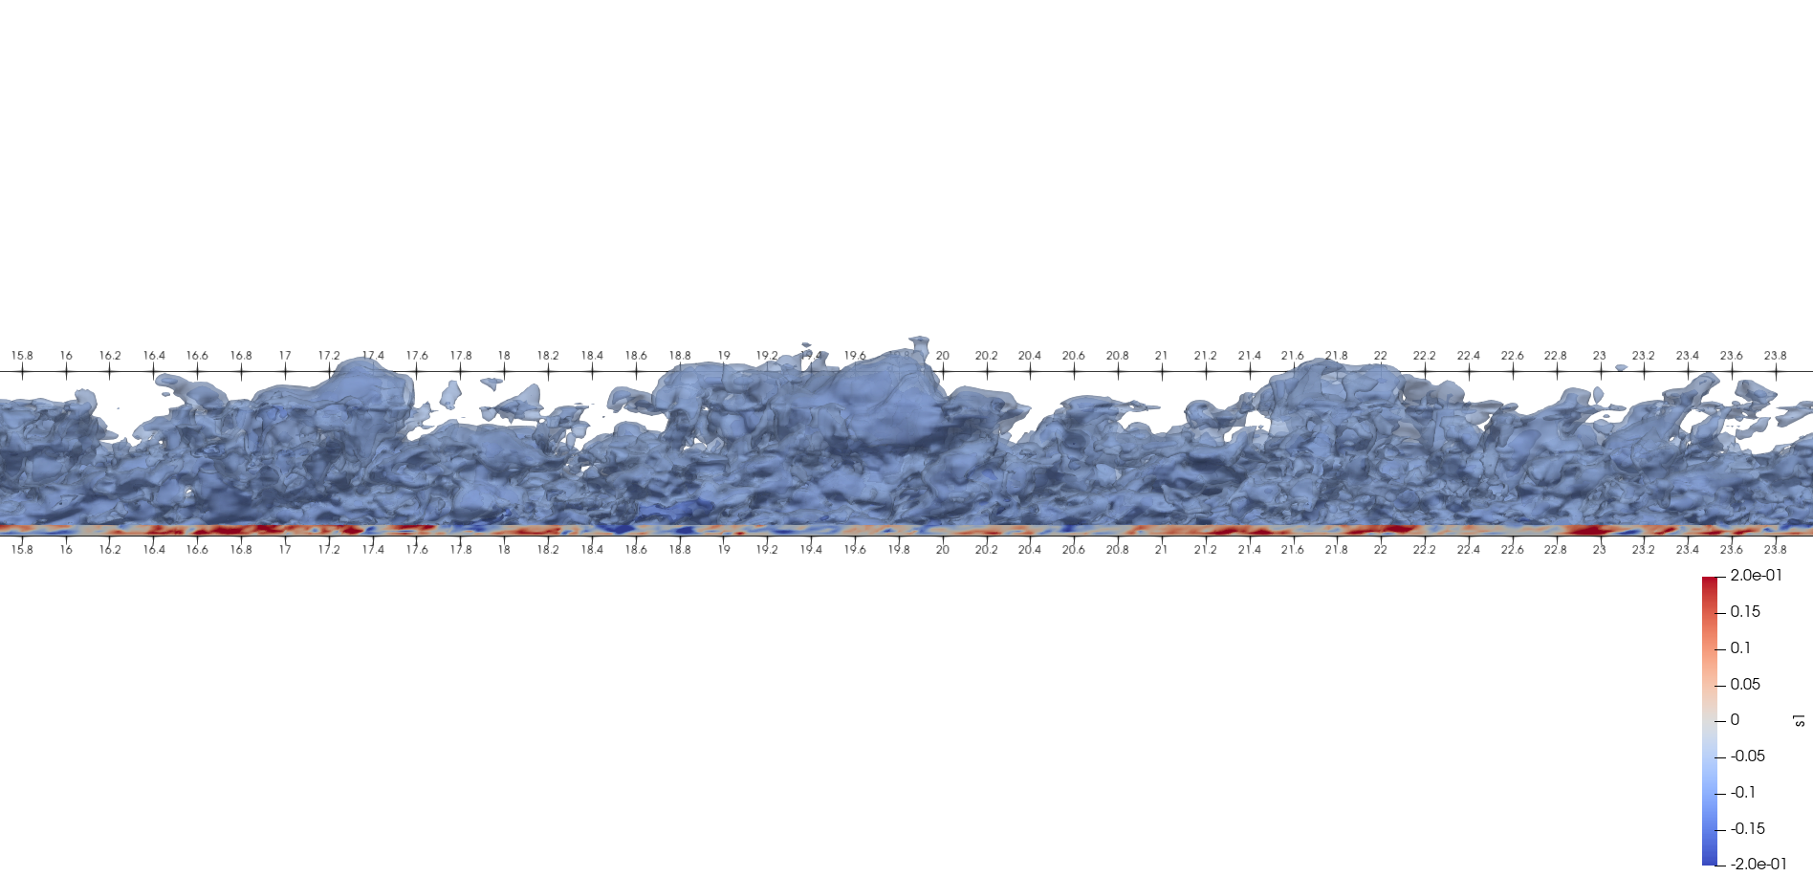
Side View of Negative Fluctuations
Slow
δ₉₉
Negative velocity fluctuations reside higher in the boundary layer

Slide 8
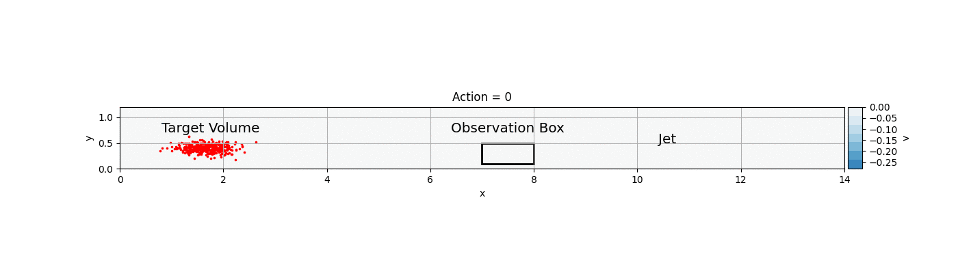
Model Predictive Control of LSMs
Detect
Volumes of LSMs to target
Predict
LSM Movement
Actuate
Create downwash when LSM is near the actuator

Slide 9
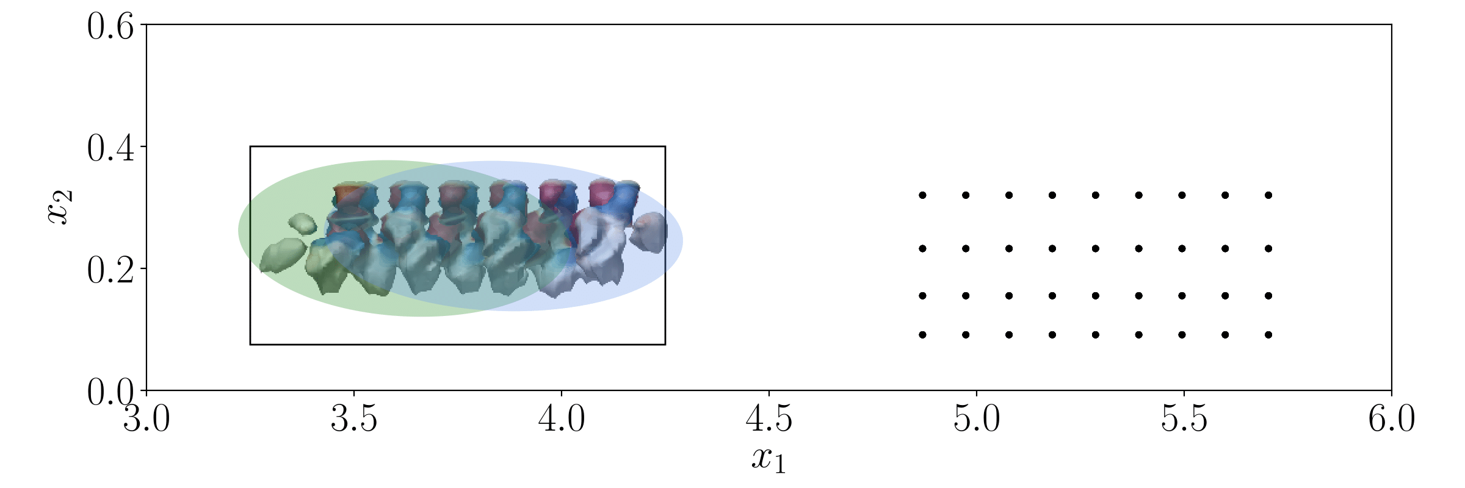
Detect an LSM
Volume can be represented with a Gaussian mixture
Use the 3D flowfield to directly detect LSMs (e.g. by low-pass filtering the streamwise velocity fluctuations)

Slide 10
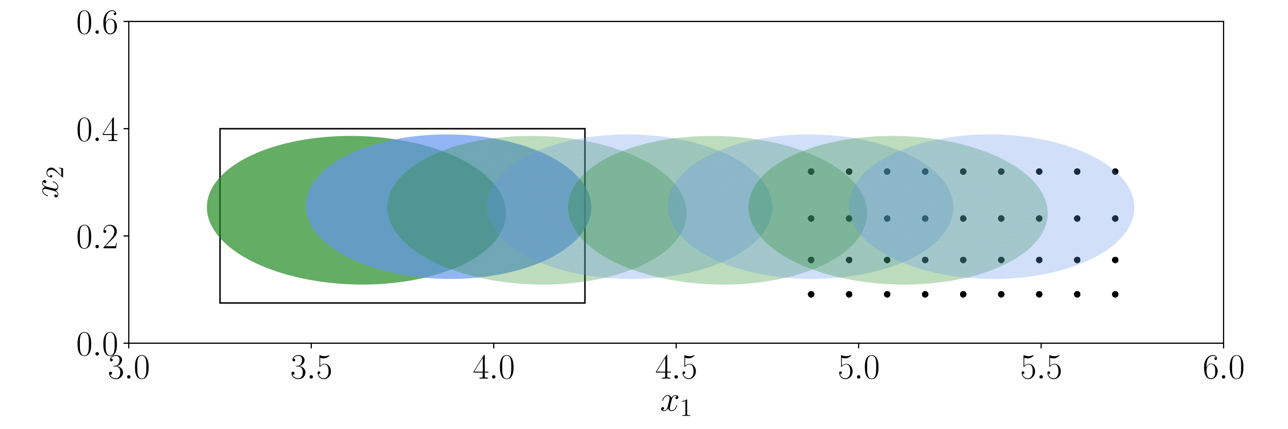
Predict LSM Trajectory
Use Taylor’s hypothesis to predict the trajectory of an LSM

Slide 11
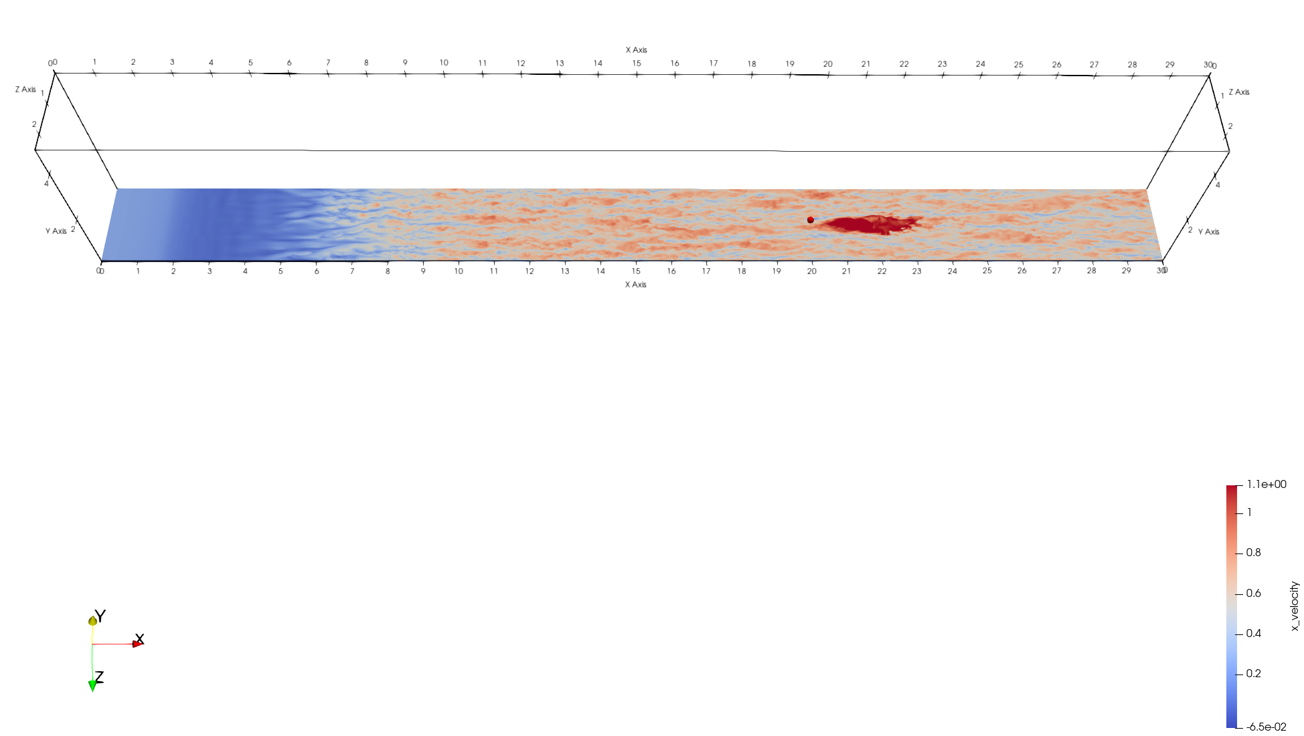
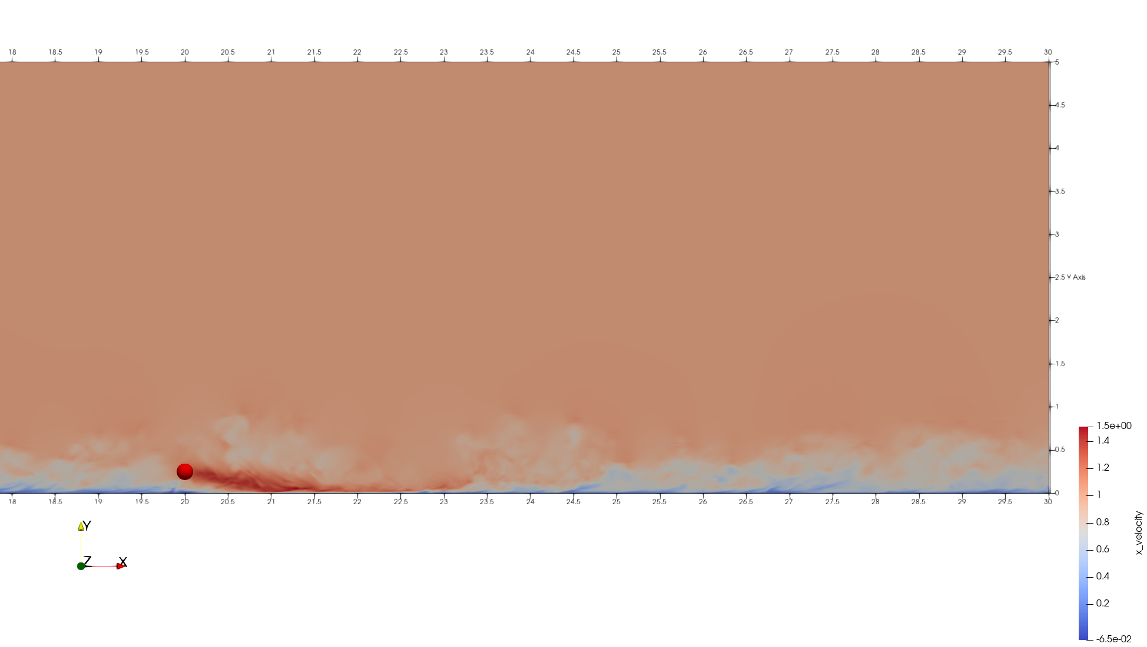
Creating Downwash
Gaussian Jet
Mid-plane streamwise velocity
45 deg pitch angle

Slide 12
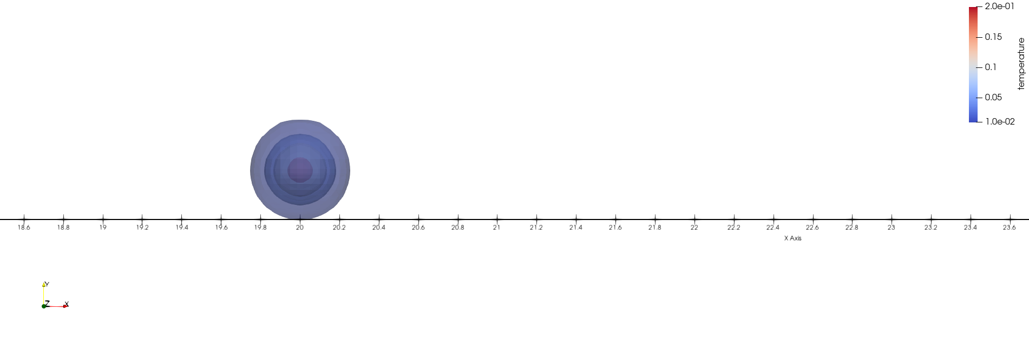
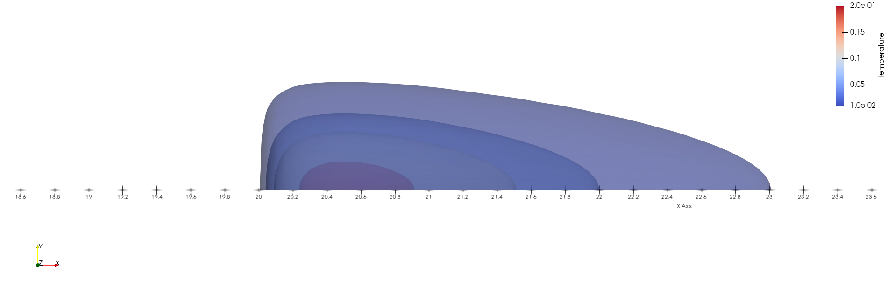
Force Field Distributions (x-y plane)
Fx = -Fy
Off-the-wall Gaussian Jet
Wall-mounted Gamma Distribution Jet

Slide 13
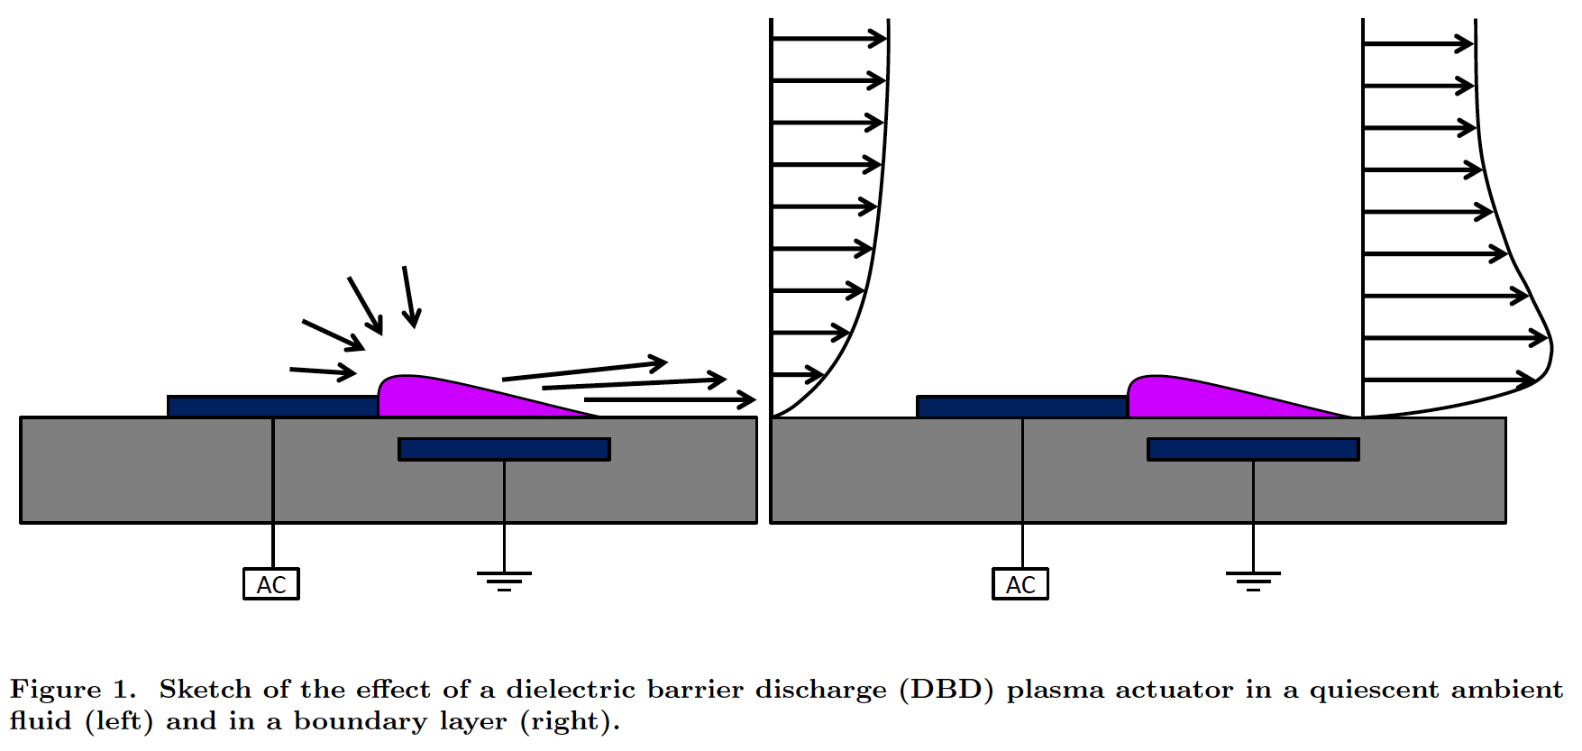
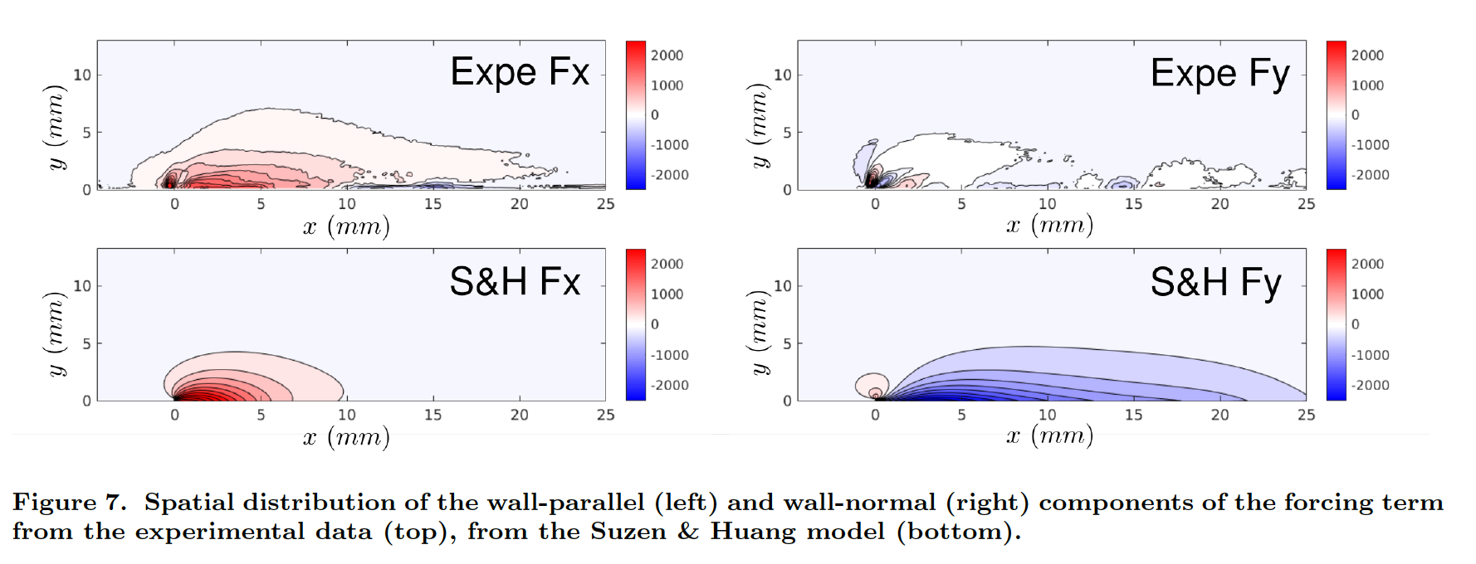
Plasma Actuators*
Flow entrainment
Body Forces of a Plasma Actuator
Experiment
Suzen & Huang Model
*Brauner, T., Laizet, S., Benard, N. and Moreau, E., 2016. Modelling of dielectric barrier discharge plasma actuators for direct numerical simulations. In 8th AIAA Flow Control Conference (p. 3774).

Slide 14
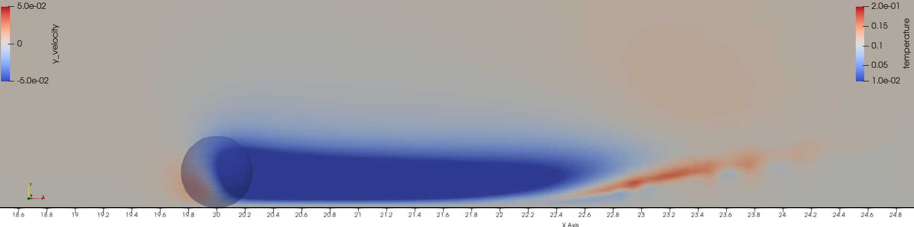
Gaussian Jet: Mid-plane Wall-Normal Velocity

Slide 15
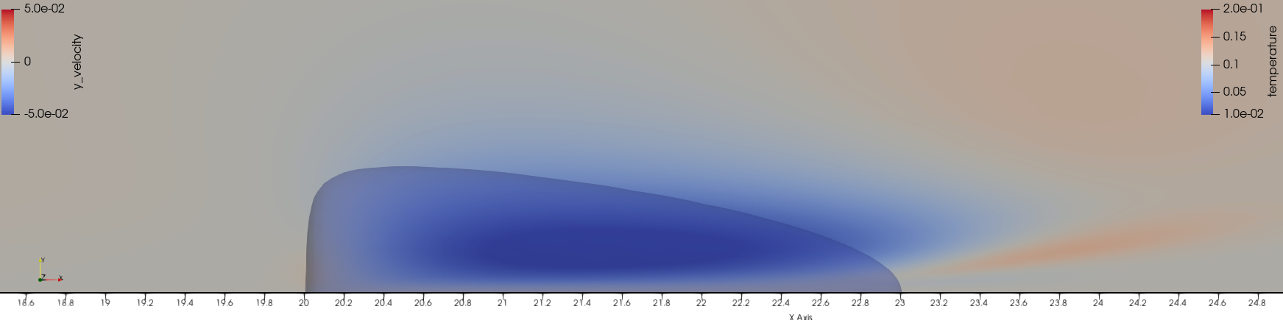
Gamma Jet: Mid-plane Wall Normal Velocity

Slide 16
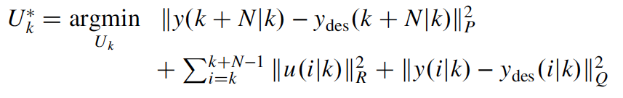
Optimal Output Tracking Control
Optimal Control Inputs
Jet Magnitude
Minimize Control Effort
Maximize Downwash
We need a model for predicting the downwash for a given input

Slide 17
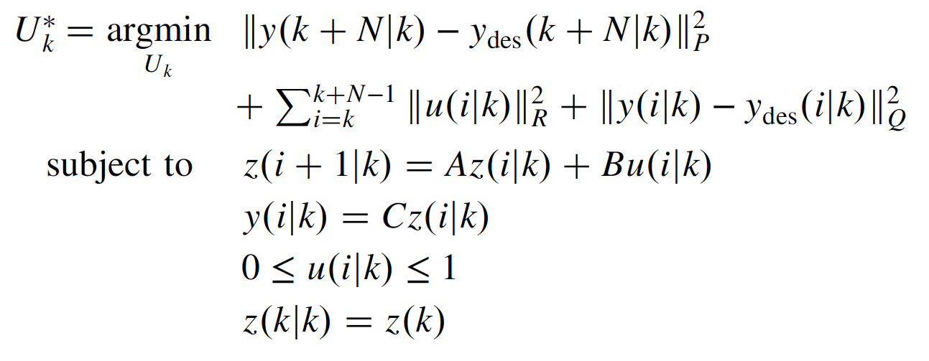
Optimal Output Tracking Control
Minimize Control Effort
Optimal Control Inputs
Jet Magnitude
Maximize Downwash
ROM Dynamics
+
Input Constraints
We need a model for predicting the downwash for a given input

Slide 18
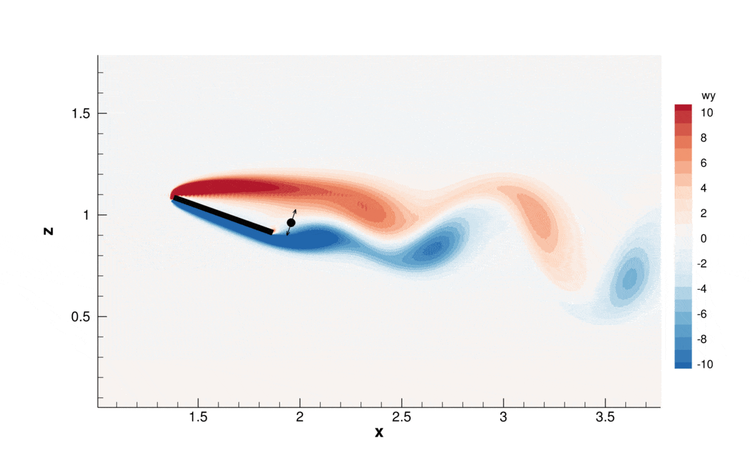
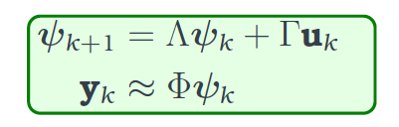
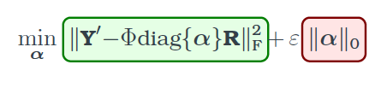
Sparsity-Promoting DMD with Control
DMDc Reduced-Order Model:
Sparsity-Promoting Optimization:
Use reweighted L1 norm instead
Tsolovikos et al., Estimation and Control of Fluid Flows Using Sparsity-Promoting Dynamic Mode Decomposition, IEEE Control Systems Letters, 2021

Slide 19
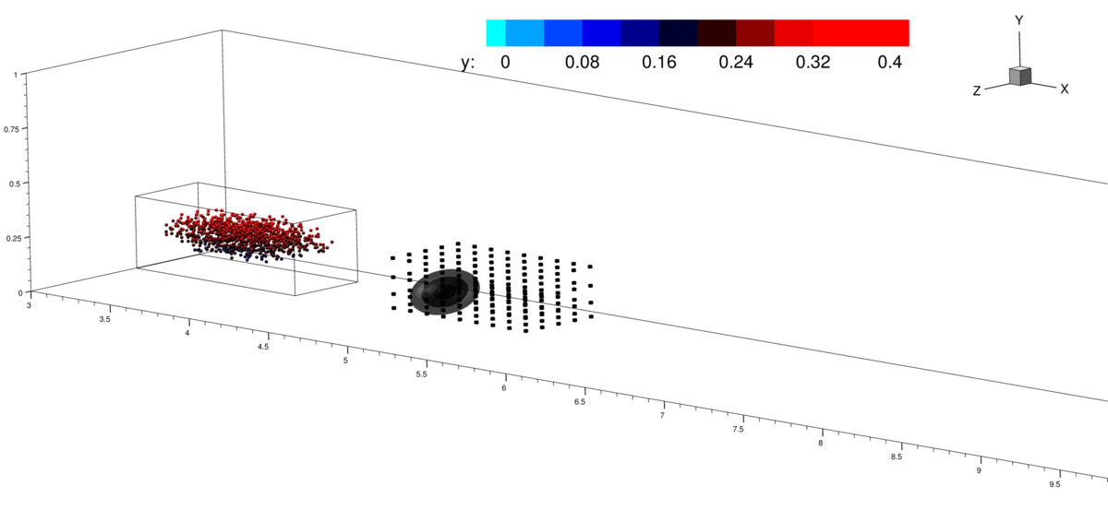
Control of Fluid Volumes | Laminar Boundary Layer
Volumes visualized by particles
Tsolovikos et al., Model Predictive Control of Material Volumes with Application to Vortical Structures, AIAA Journal, 2021

Slide 20
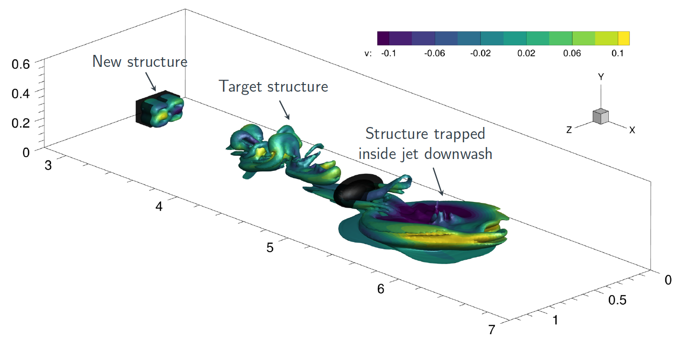
Control of Synthetic LSMs | Laminar Boundary Layer

Slide 21
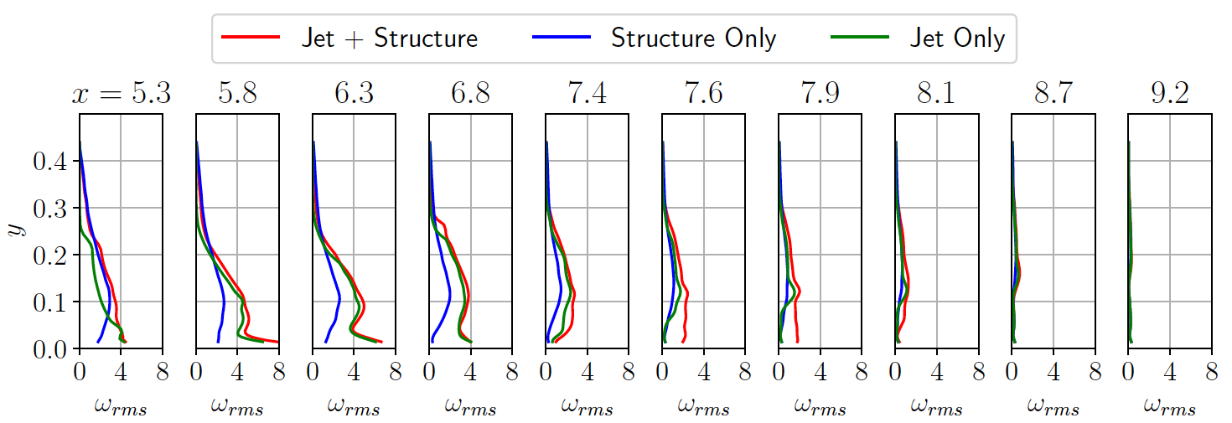
Control of Synthetic LSMs
Change in Vorticity Fluctuation RMS when targeting a synthetic LSM

Slide 22
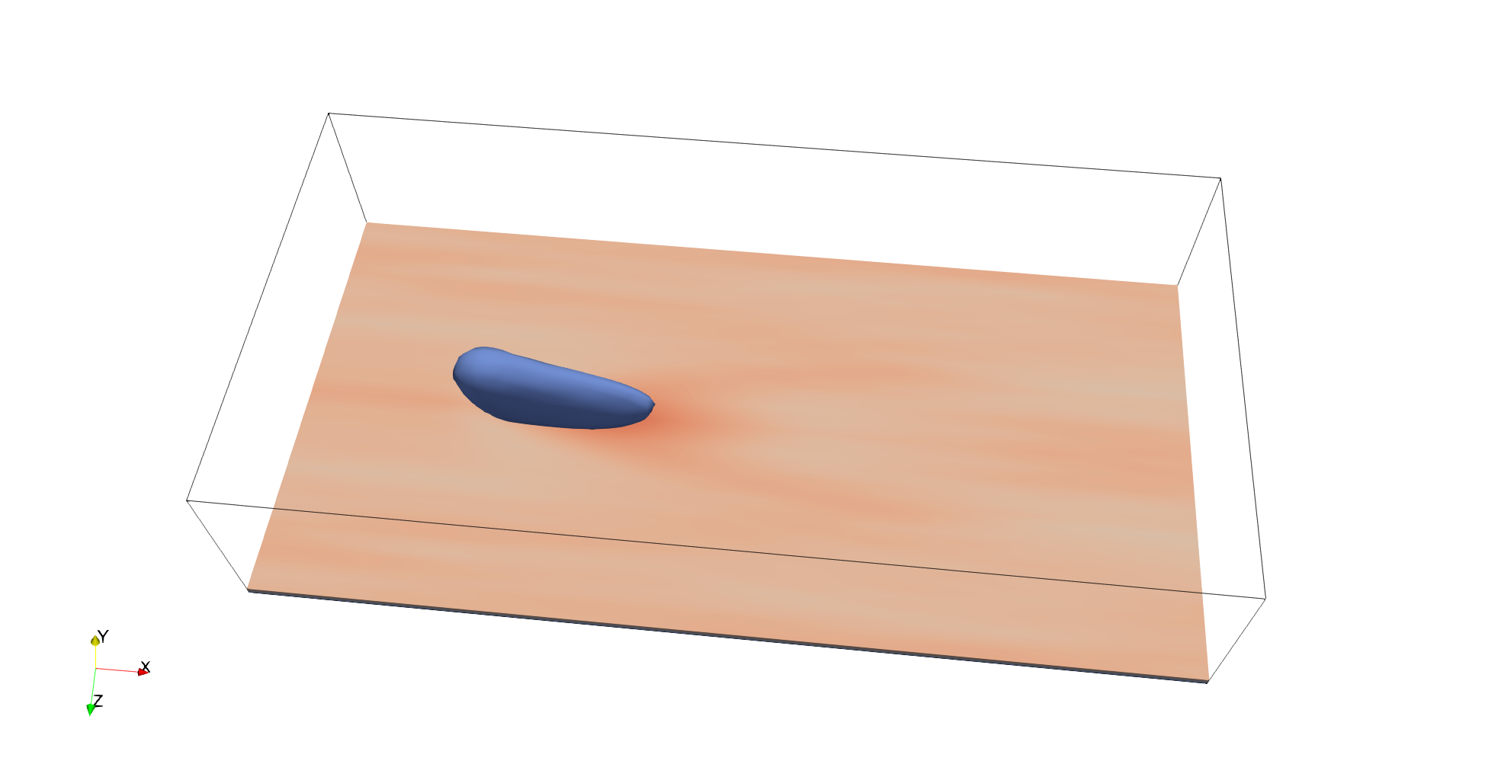
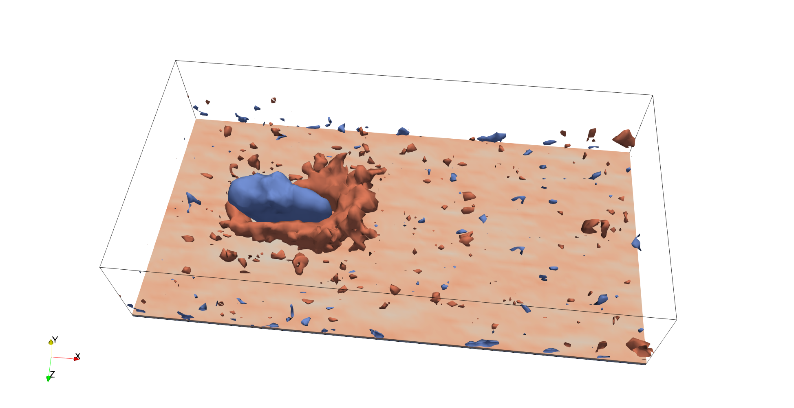
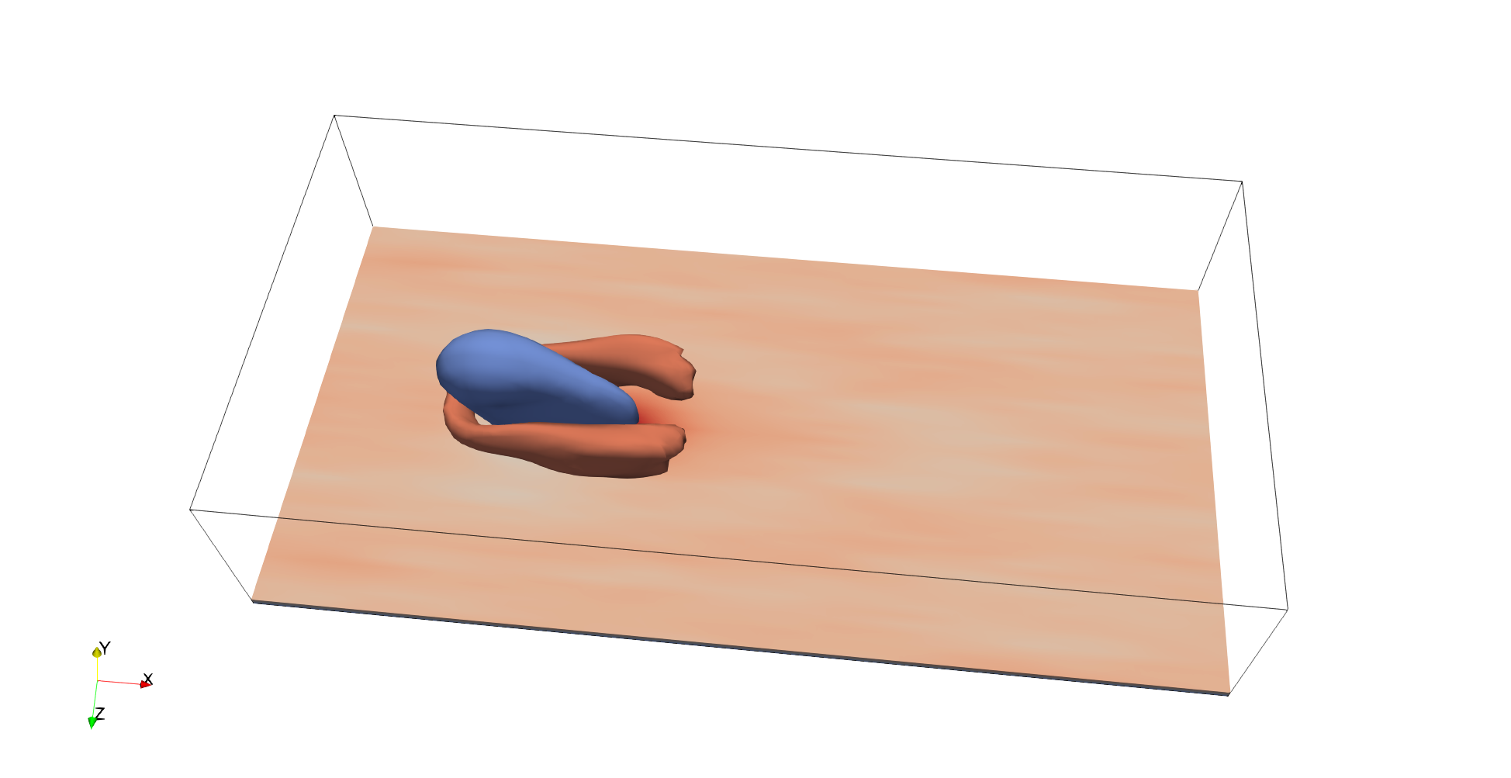
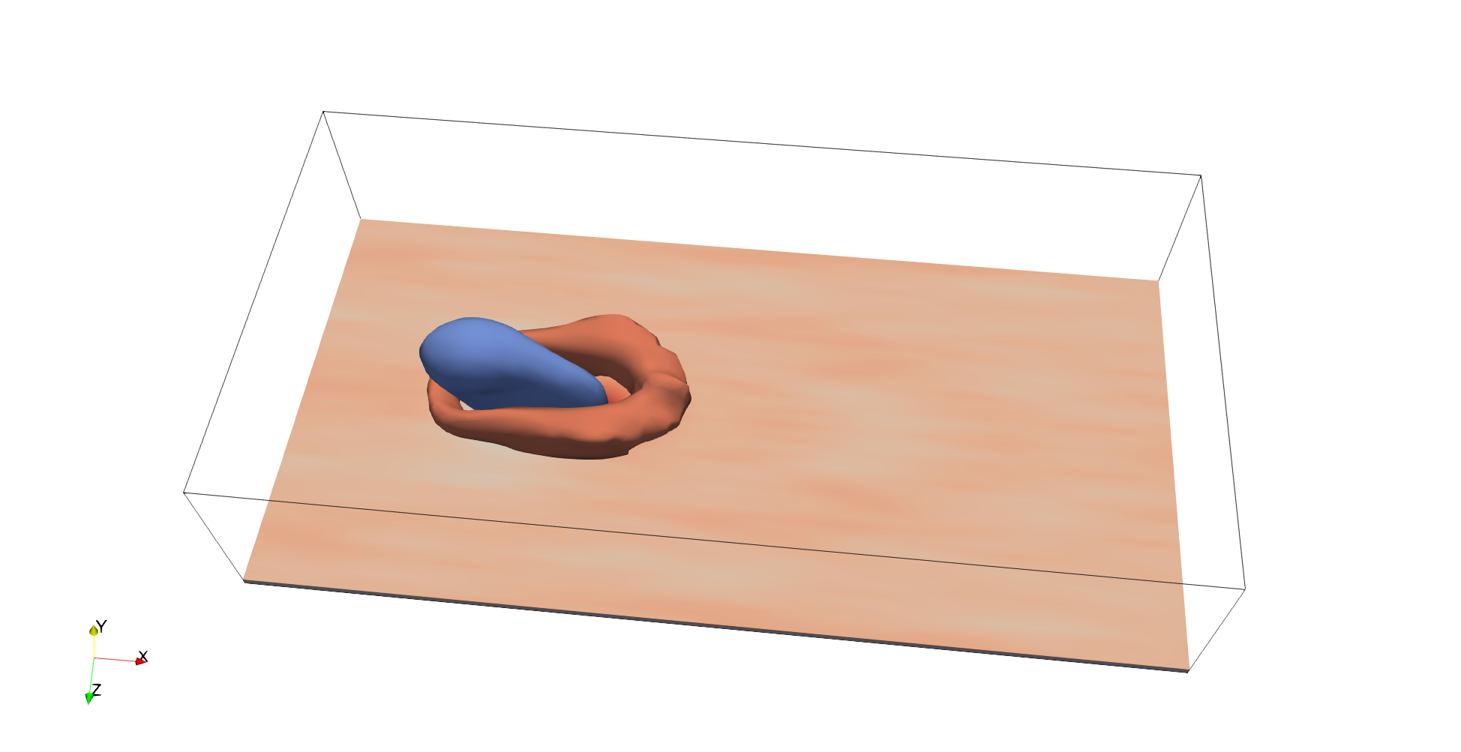

Reduced-Order Models for
Downwash Prediction
DMDc
DNS Ensemble Average
tlsDMDc
Best POD Projection
tlsDMDc + GP*
*To be published

Slide 23
Reinforcement Learning (No Model Needed)
Proximal Policy Optimization with LSTM policy and discrete actions (jet is on/off)

Slide 24
Next Steps
LSMs in an adverse pressure gradient turbulent boundary layer
MPC control of LSMs for separation delay
Large-eddy simulations to speed up computations
Dynamic Mode Decomposition + Gaussian Processes for more accurate flowfield predictions
Reinforcement learning for LSM control
alextsolovikos.github.io

